Slide 1
Sea Level Rise
Deb Hughes Hallett
University of Arizona/Harvard Kennedy School
Mathematics Consortium Working Group
https://mcwg.github.io/
https://mcwg.github.io/climate
© 2022 Mathematics Consortium Working Group, Hughes Hallett et al.

Slide 2
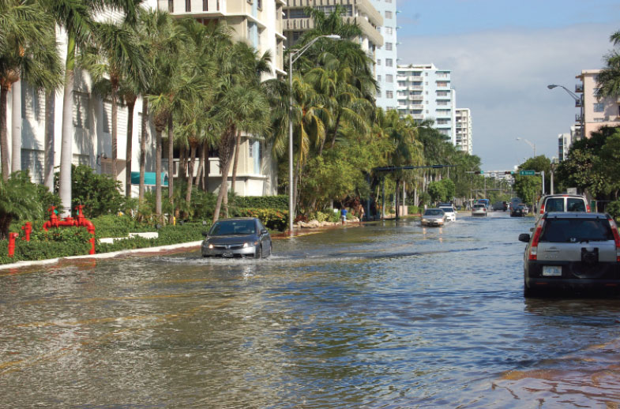
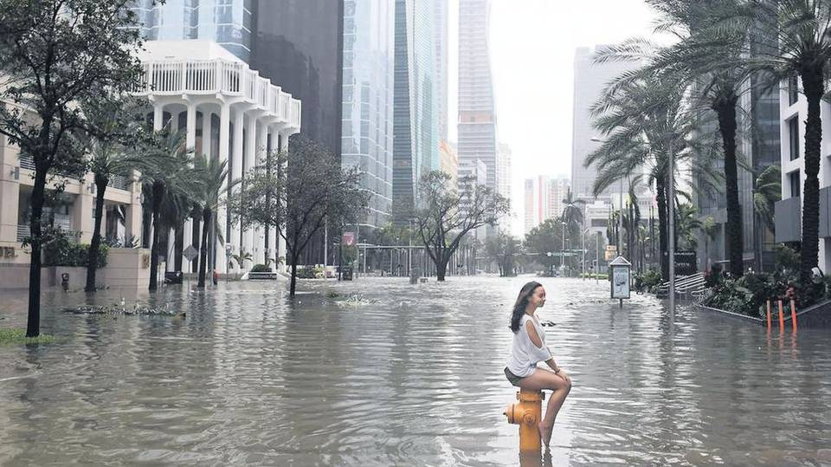
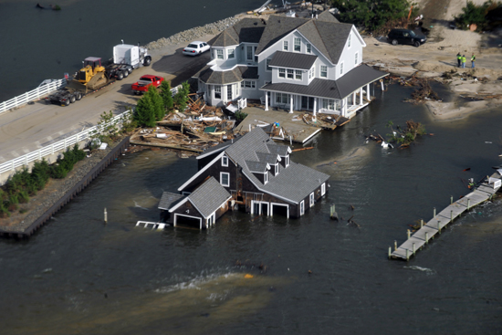
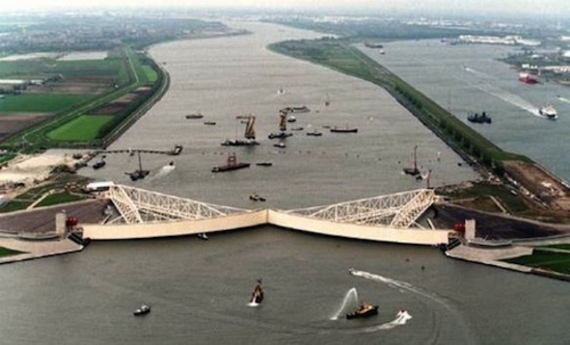
Sea Level Rise and its Costs
Miami
Miami
Data
Hurricane Sandy in New York caused up to $70 billion in damages
Katrina caused $125 billion in losses in New Orleans, much of it due to rising water.
Here we look at a simplified estimate of some of the threats facing Boston in the 21st C
New Jersey
Netherlands
https://www.miamitodaynews.com/2016/09/13/miami-getting-serious-sea-level-rise/
https://www.miamiherald.com/opinion/editorials/article224405100.html
http://www.bu.edu/articles/2012/lessons-from-hurricane-sandy/
https://www.climatecentral.org/news/floods-may-cost-coastal-cities-60-billion-annually-by-2050-16356

Slide 3
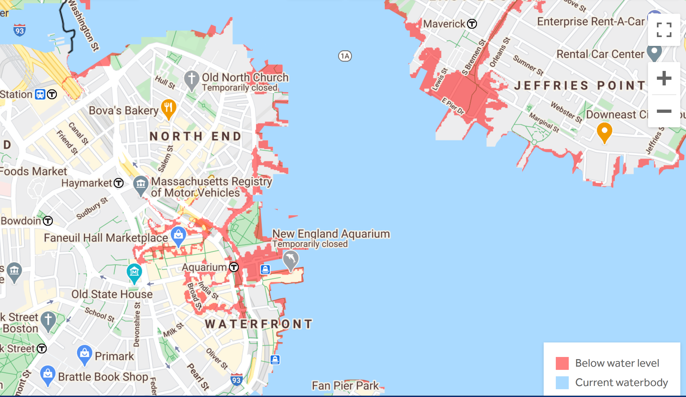
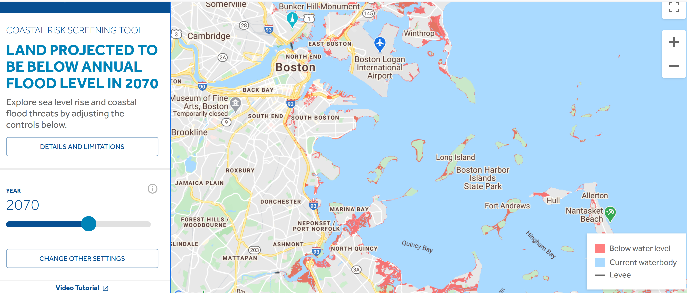
Flood Predictions: Boston and Surroundings
https://coastal.climatecentral.org/map/

Slide 4
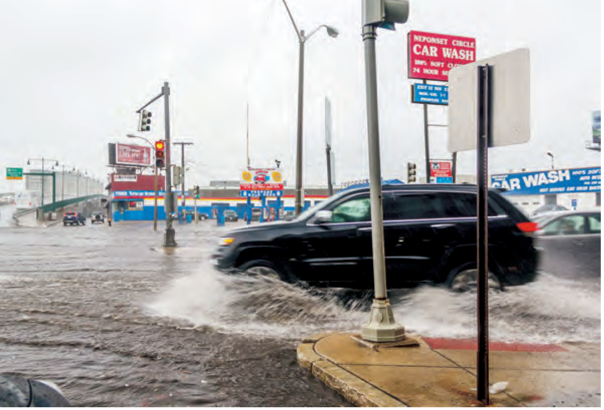
How Might We Address Future Damages?
Financing Climate Resilience
https://e360.yale.edu/features/who-will-pay-for-the-huge-costs-of-holding-back-rising-seas
“By 2070, some neighborhoods in Boston could flood monthly, resulting in $1.4 billion in annual losses to businesses and property.”
(Climate Ready Boston https://www.boston.gov/departments/environment/preparing-climate-change)
How much should Boston be willing to spend in 2020 to avoid one of the $1.4 billion costs?
We imagine a choice between
Investing $ billion today say at a 1% per year continuous interest rate
Spending that money preventatively, to build sea walls and drainage channels
First Option
To meet the $1.4 payment, should grow to $1.4 in 50 years, so in billions
That is, about $849 million.
Budget comparison: For 2021, Boston’s operating budget is $3.6 billion, capital budget is $3.0 billion for 2021-2025.
$1,400 mil is future value, FV
$849 mil is present value , PV
1% per year is the discount rate
$PV=FVe^{−0.01t}$
https://www.boston.gov/departments/budget/

Slide 5
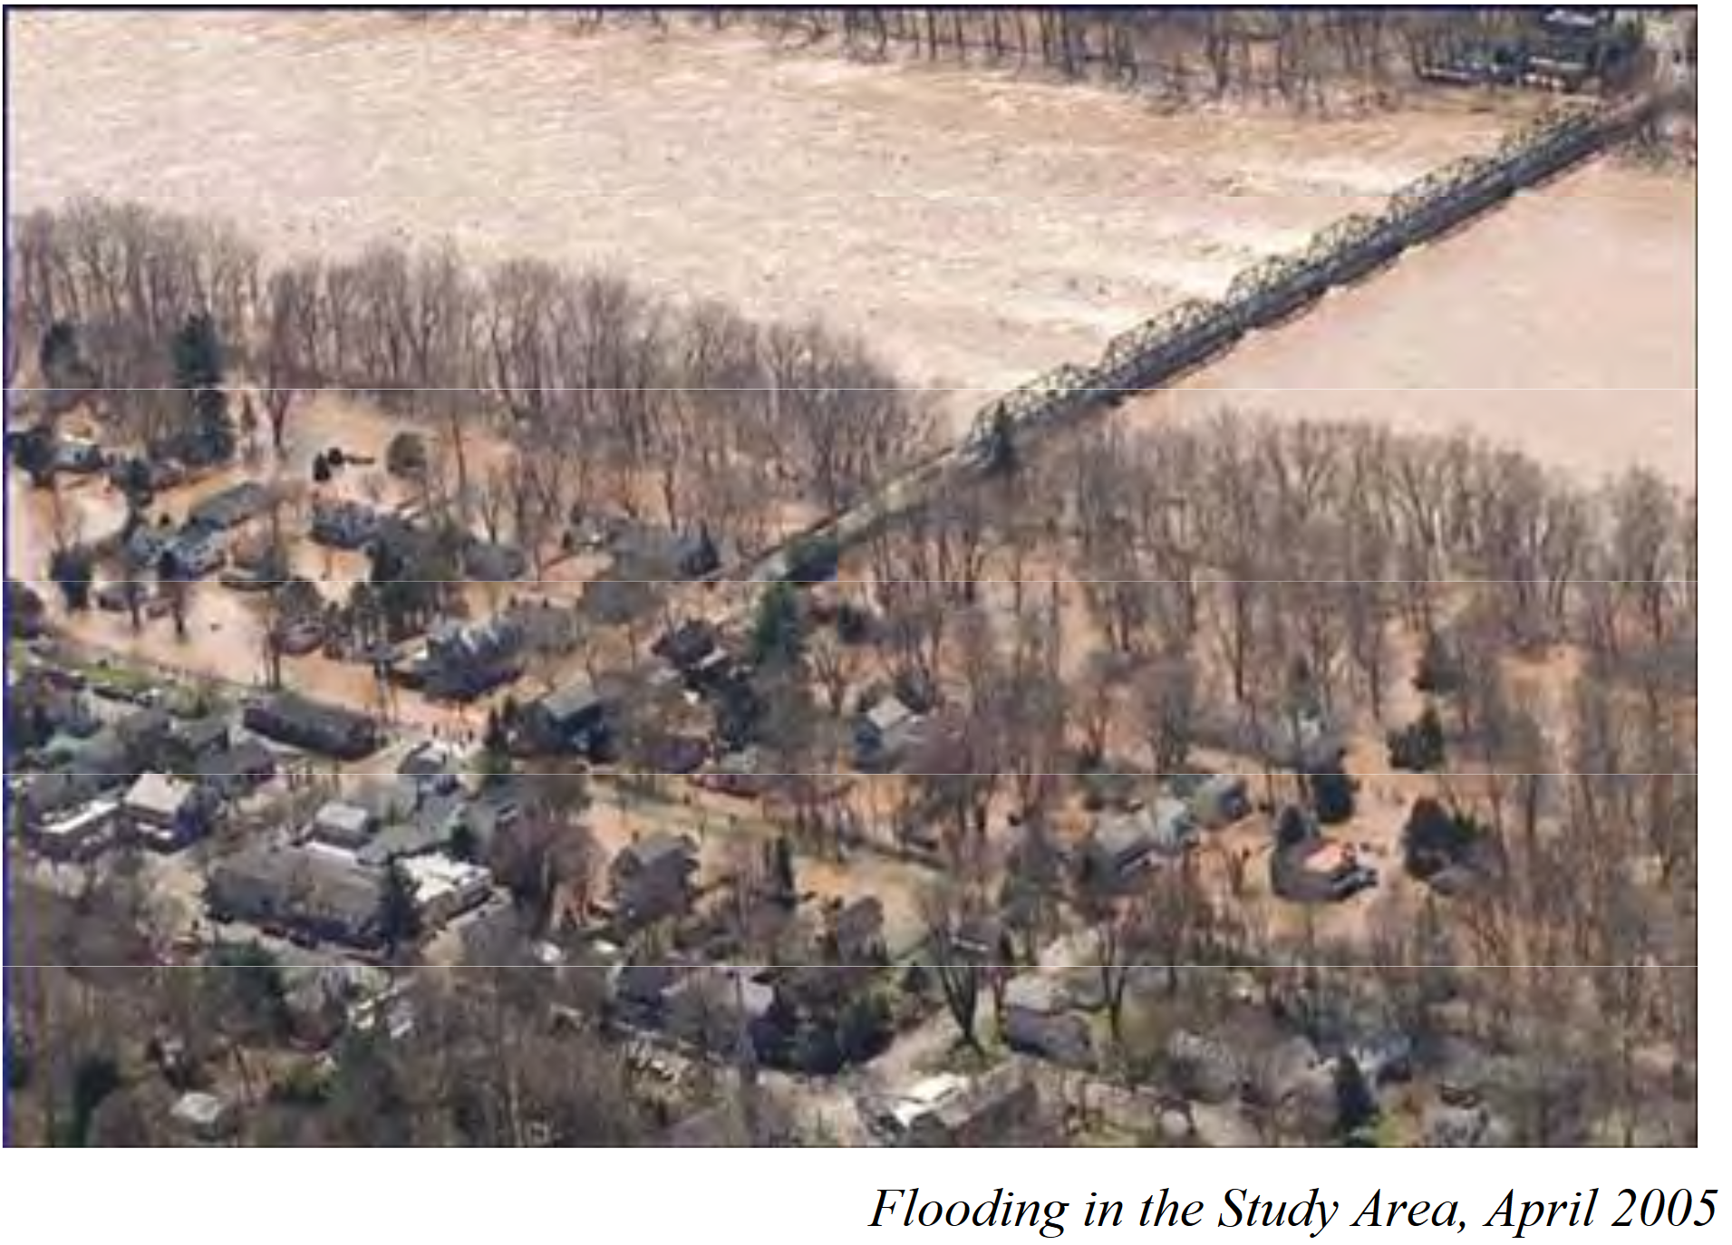
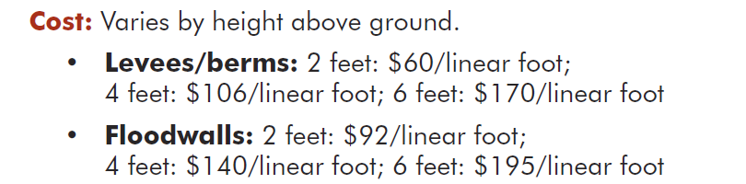
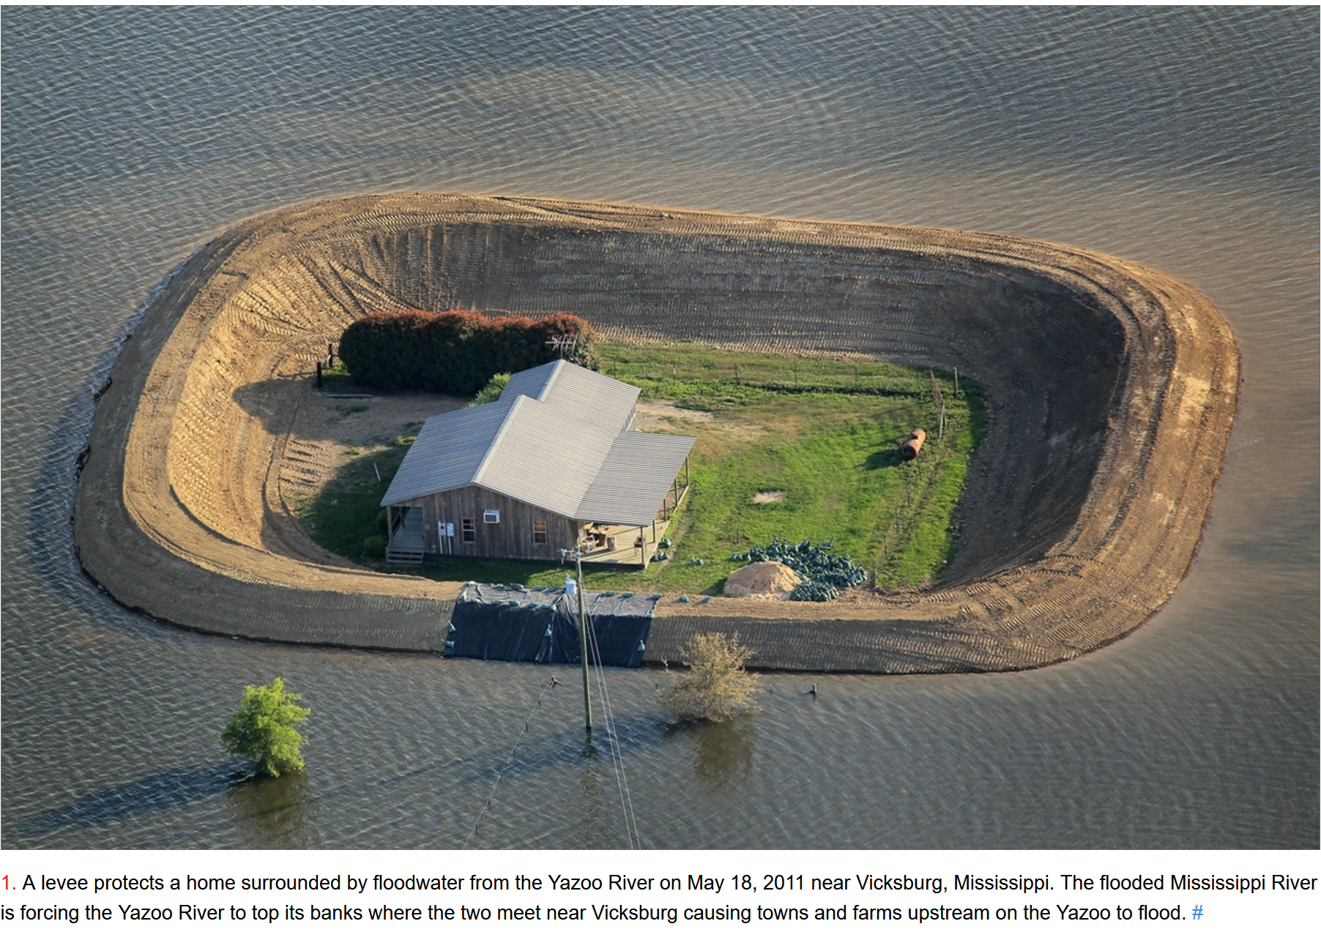
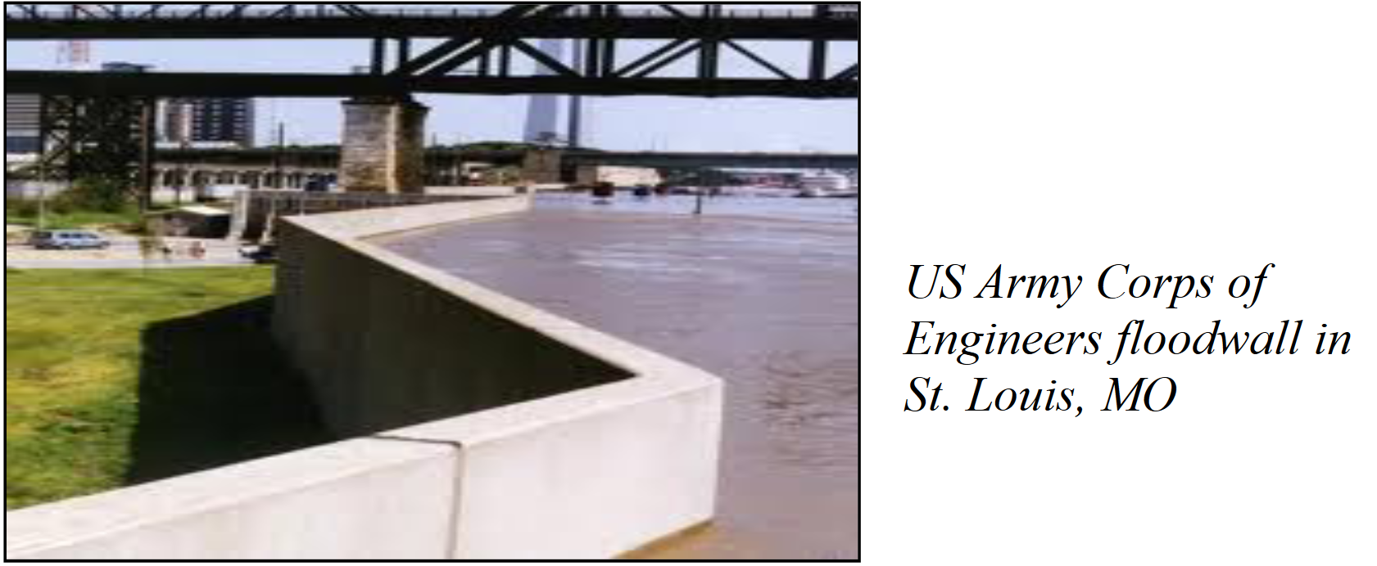
Adapting to Sea Level and River Rise Flood Walls or Levees? At What Cost?
New Jersey: 2005
A Better City: “Enhancing Resilience in Boston” February 2015
https://www.theatlantic.com/photo/2011/05/mississippi-floodwaters-roll-south/100069/
https://www.nap.usace.army.mil/Portals/39/docs/Civil/DelComp/Levees%20and%20Floodwalls.pdf
Levee
Mississippi: 2011
Missouri: 2015
Flood Wall

Slide 6
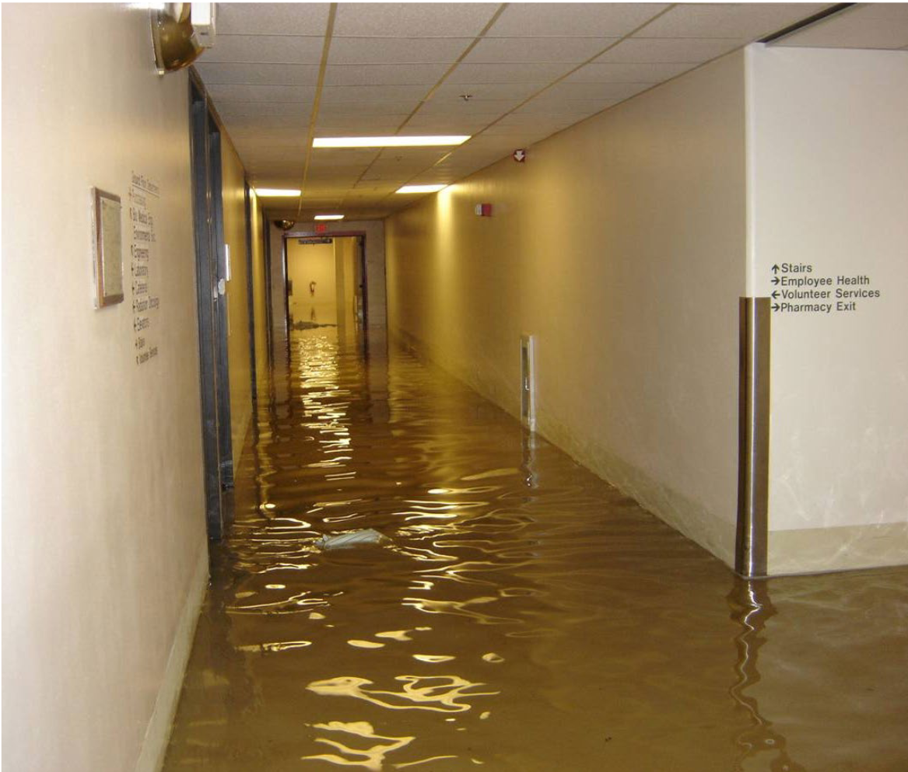
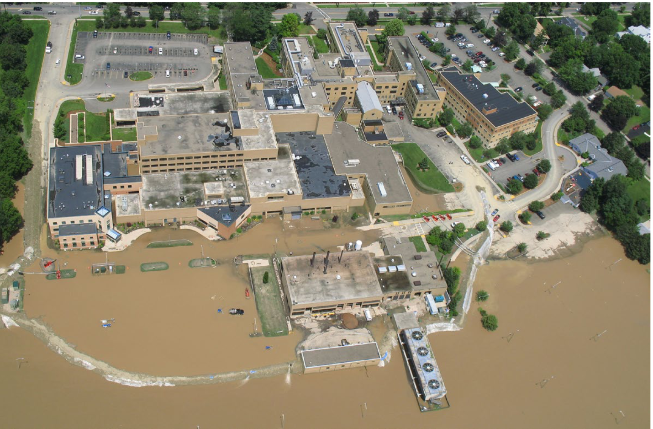
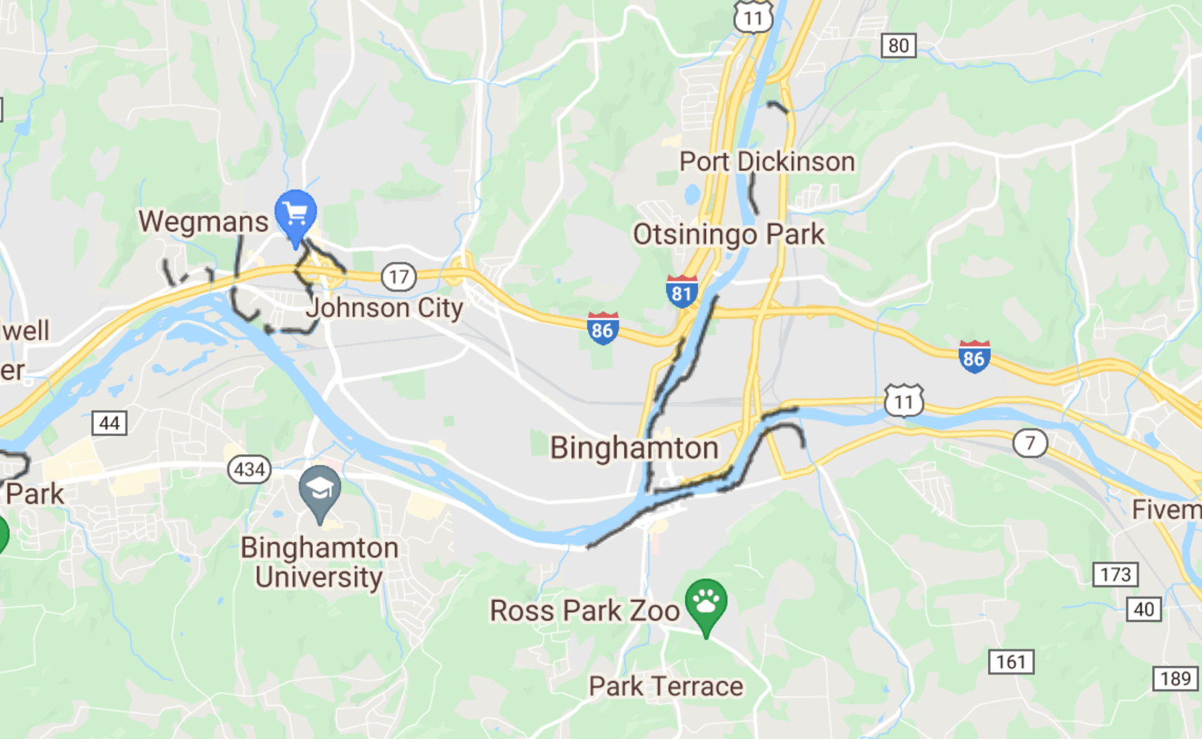
Lourdes Hospital, Binghamton, NY
2006 Flood
http://floodbreak.com/wp-content/uploads/2012/08/FEMA_FloodMitigationBestPractice_Lourdes-Hospital_Detail-copy.pdf
https://www.tidalbasingroup.com/assets/CaseStudy/5f5596ee3f/Lady-of-Lourdes-Hospital-Flooding.pdf
June 2006 Flood: Hospital first floor 16-20” water and raw sewage. Had to evacuate patients and close for 2 weeks; $20 million damage
Summer 2010: Concrete 11-foot floodwalls to 500-year flood level. Cost $7 million

Slide 7
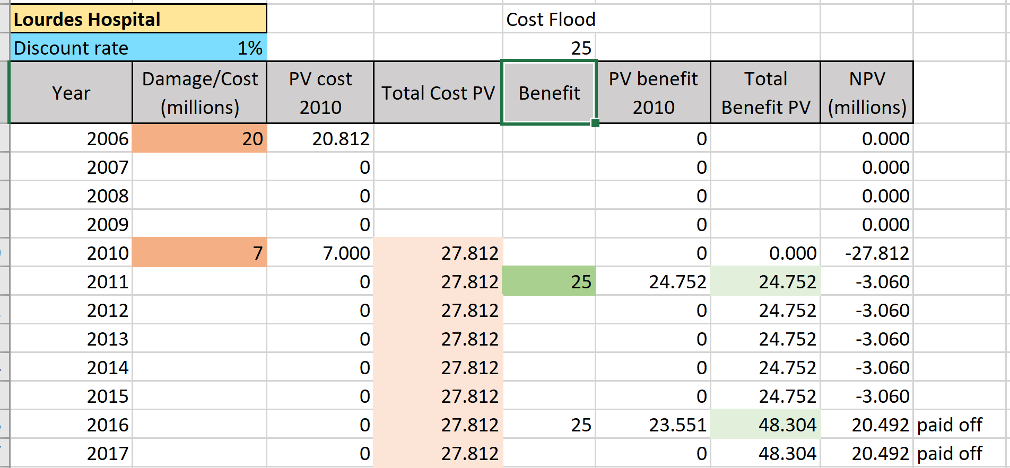
Analyzing the Expenditure for Lourdes Hospital Wall
Convert all costs and benefits to the Present Value. Exponential decay
Benefits (a.k.a. absence of damage) and some costs have to be estimated. For example: without wall, flood every five years with damage $25 million
Net Present Value, ,
If project has paid off
Observe how depends on discount rate

Slide 8
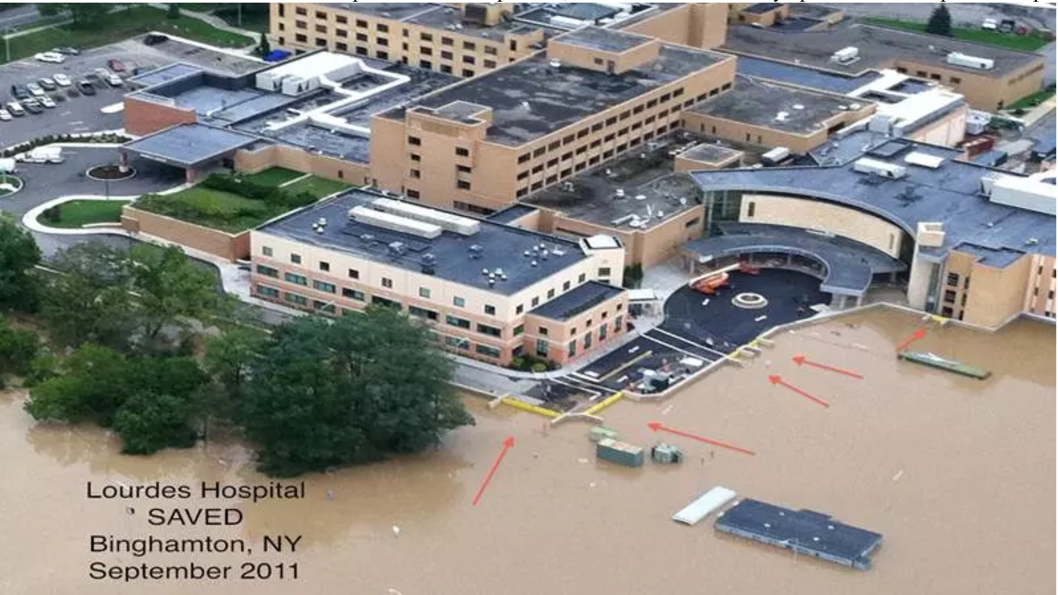
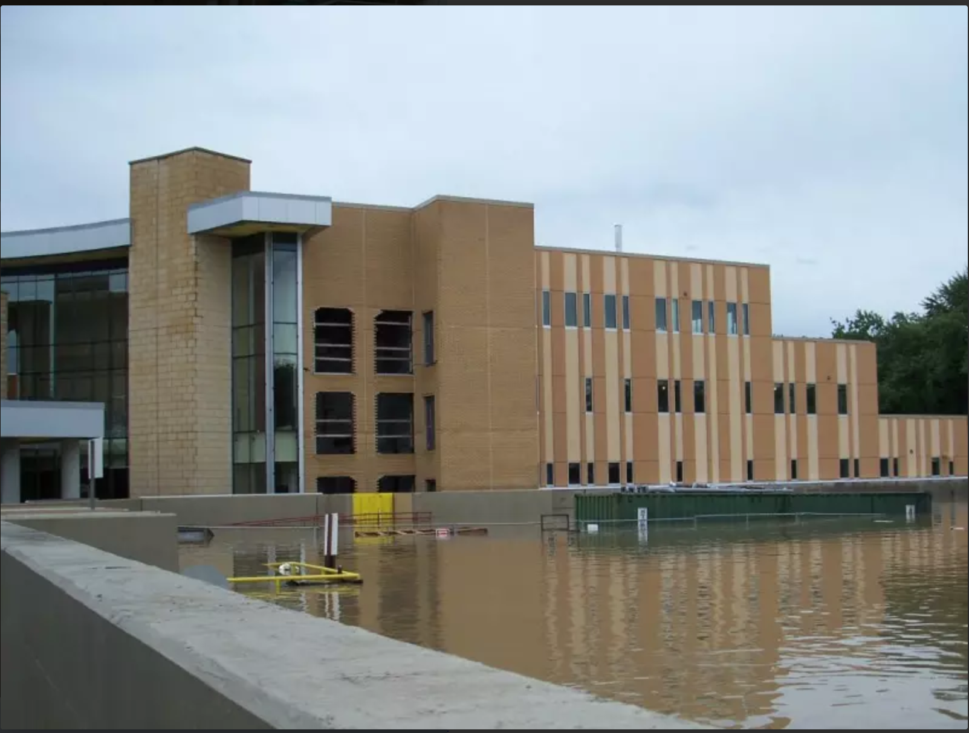
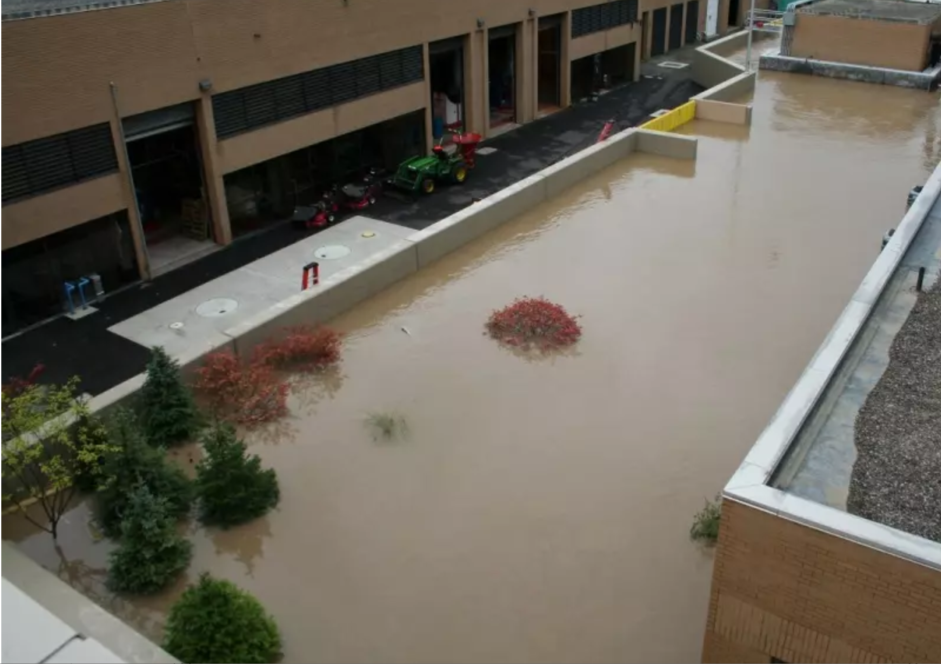
Lourdes Hospital, NY
http://floodbreak.com/floodbreak-protects-lourdes-hospital-during-historic-2011-flood/
2011 Flood
September 2011 Flood: Tropical storm Susquehanna river reached 11 feet above 2006. This time the hospital remained fully operational
"The floodwall itself worked magnificently, the gates operated as expected,"
The floodwaters came within 30” but never breached.
http://floodbreak.com/wp-content/uploads/2012/08/FEMA_FloodMitigationBestPractice_Lourdes-Hospital_Detail-copy.pdf
https://www.tidalbasingroup.com/assets/CaseStudy/5f5596ee3f/Lady-of-Lourdes-Hospital-Flooding.pdf

Slide 9
More climate change resources at
https://mcwg.github.io/climate
https://mcwg.github.io/climate
© 2022 Mathematics Consortium Working Group, Hughes Hallett et al.

